Slide 1


Library Management – application
A Java-based desktop application for managing library operations
Built as a university project to simplify book borrowing and tracking
Features separate portals for Students and Staff
Presented By – Jobanpreet Singh,

Slide 2
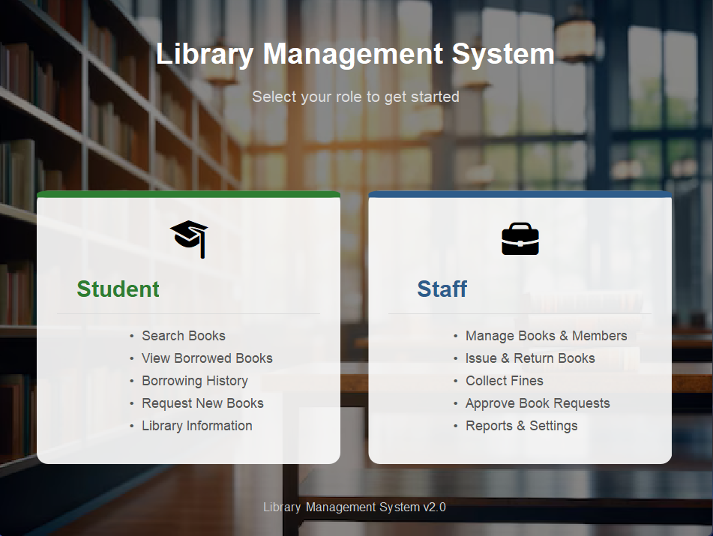
Welcome
Library Management System – Overview
Role-based access with separate Student and Staff portals
Students can search, borrow, track history, request books, and view fines
Staff can manage books, members, transactions, and approve requests
Includes a fine/penalty system for overdue books
Reports dashboard with statistic
And more

Slide 3
Technology -
Java — backend logic and data management
Java Swing — user interface (GUI)
In-memory storage — data handled using ArrayLists

Slide 4
Starting the Application
Application launches and displays a Role Selection screen
User selects either Student or Staff role
The main window opens with the selected portal
Users can switch roles anytime using the Switch Role button in the header

Slide 5
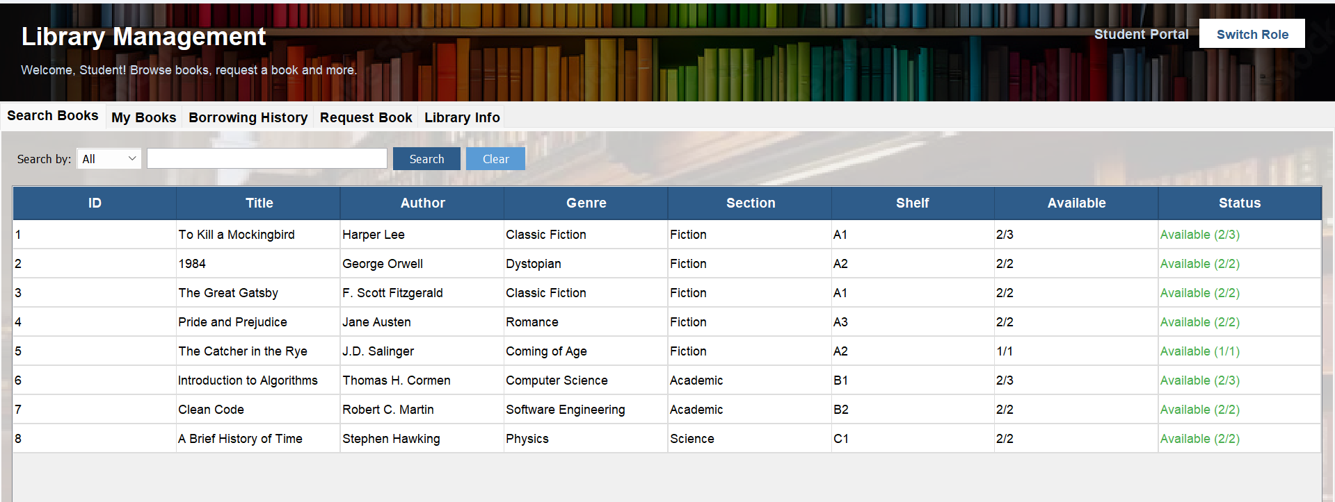
Students Section –

Slide 6
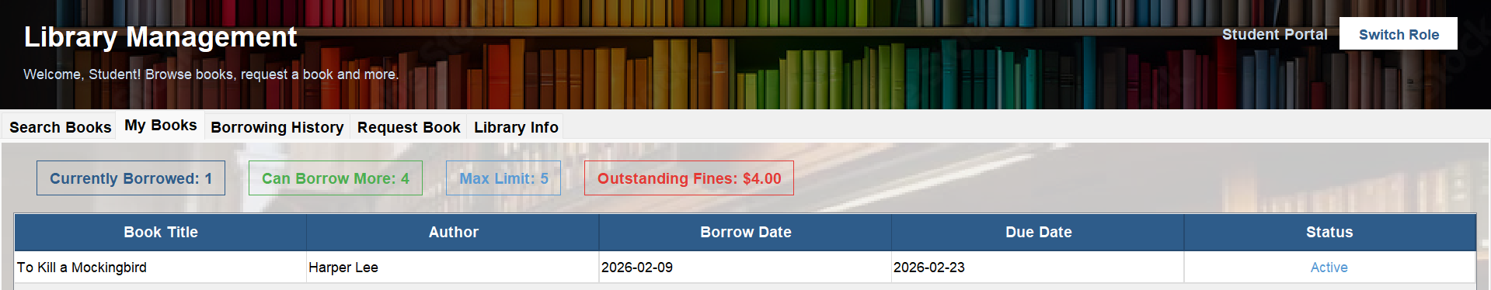
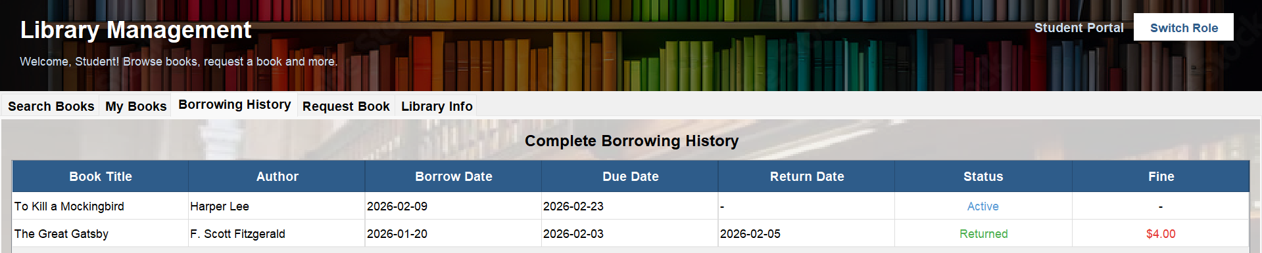
Student – My books , and history

Slide 7
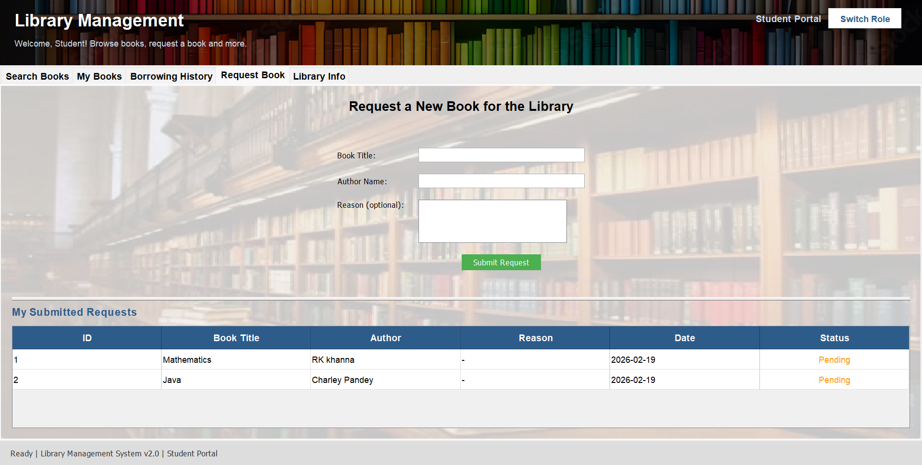
Student- Requesting a book

Slide 8
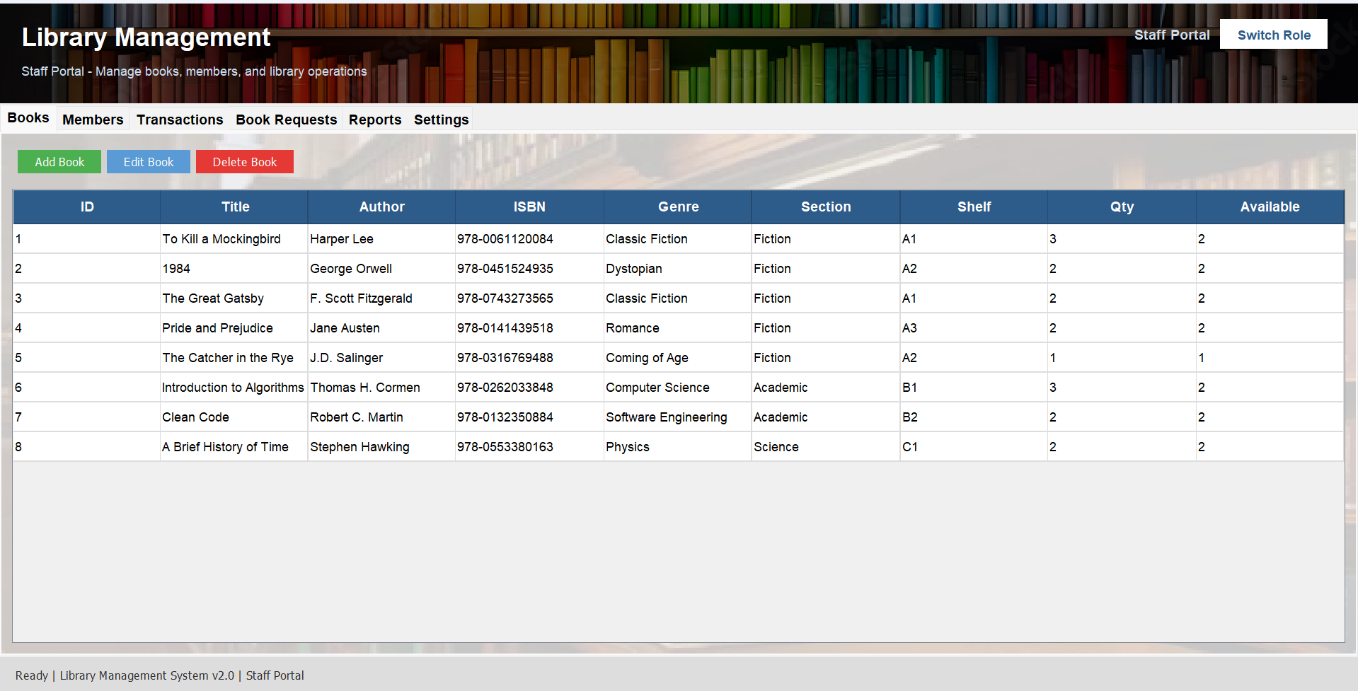
Staff Section-

Slide 9
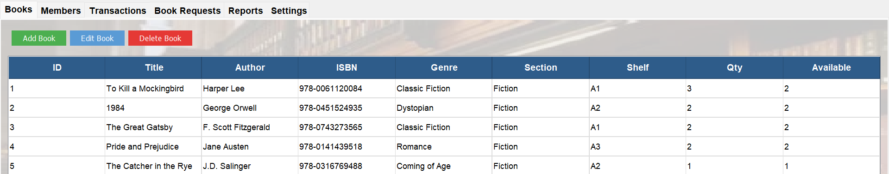
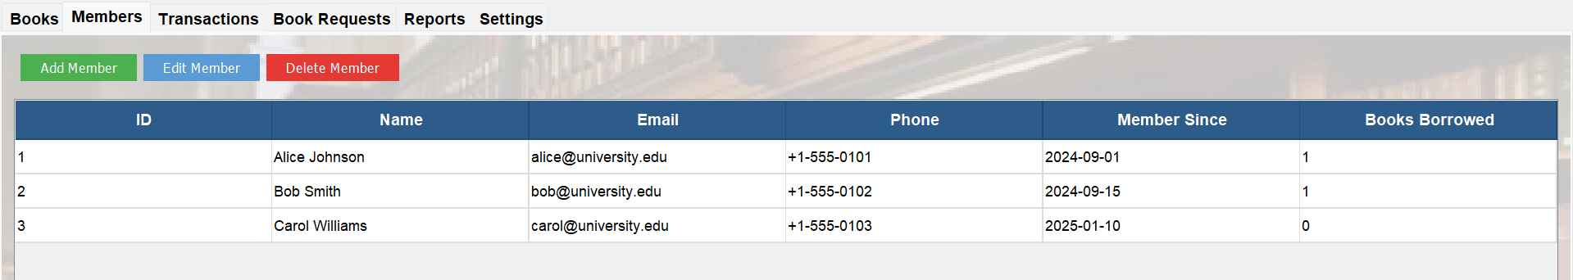
Albert Einstein
Staff – Books, Member

Slide 10
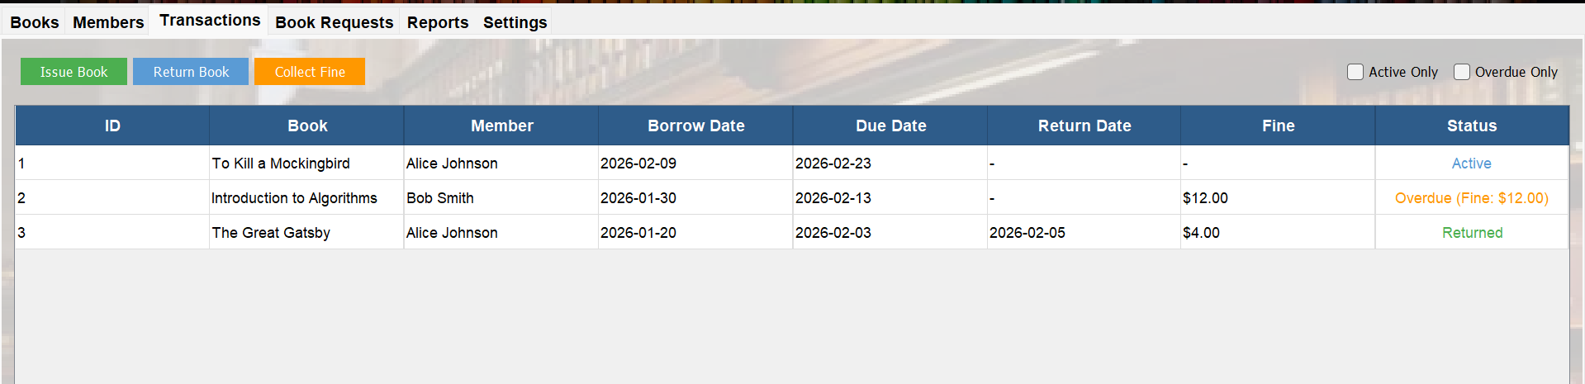
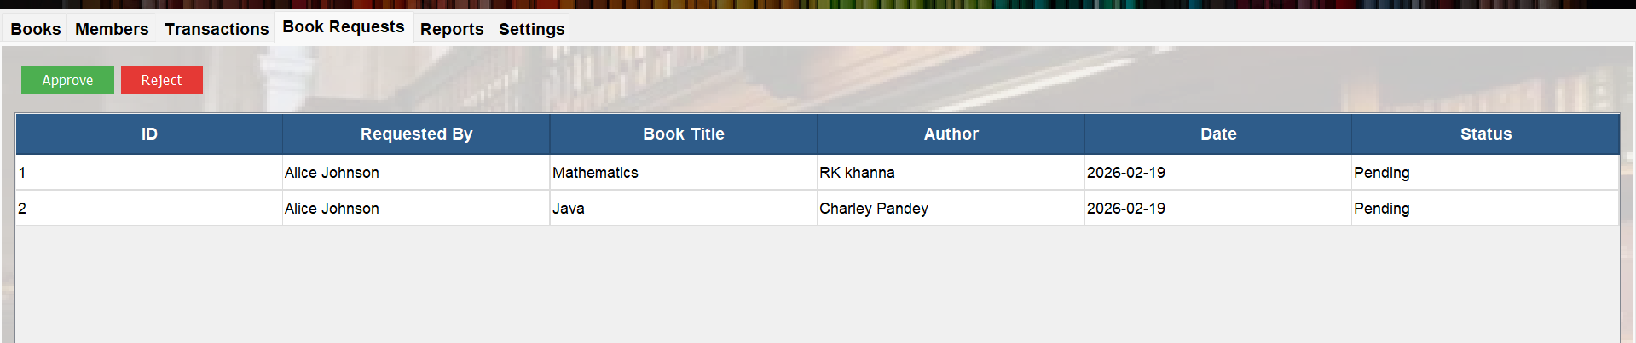
Staff- Transactions , books requested

Slide 11
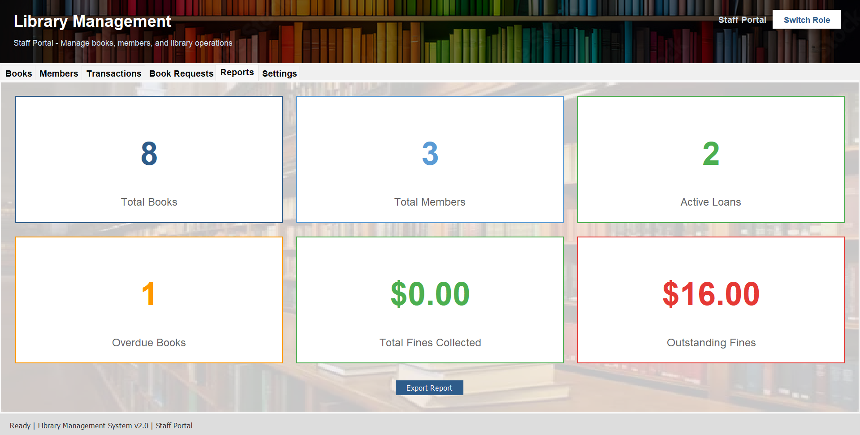
Staff- Report

Slide 12

Q & A
Panel discussion session

